Slide 1

St. Pete IoT
Brought to you by

Slide 2
St. Pete IoT
Brought to you by
Nicolas Mejia (FW Nick)

Slide 3
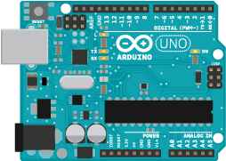
Today’s Agenda
Arduino
Them downloads…
What is Arduino?
What can we do with it?
C and C++
What is C?
Datatypes, Functions n’ stuff…
Embedded Topics
Program Flow
Lets make a program
Image from Arduino.cc

Slide 4
Arduino
Development kit for that contains
Microcontroller
USB connection
Headers for GPIOs
Download Arduino IDE at: https://www.arduino.cc/en/Main/OldSoftwareReleases
…or just google “Arduino downloads” without the quotations and do the obvious thing….

Slide 5
Arduino
MAC, Linux users and people who bought the cheap “Arduino”
FTDI
http://www.ftdichip.com/Drivers/VCP.htm
Cheap’o
https://sparks.gogo.co.nz/ch340.html

Slide 6
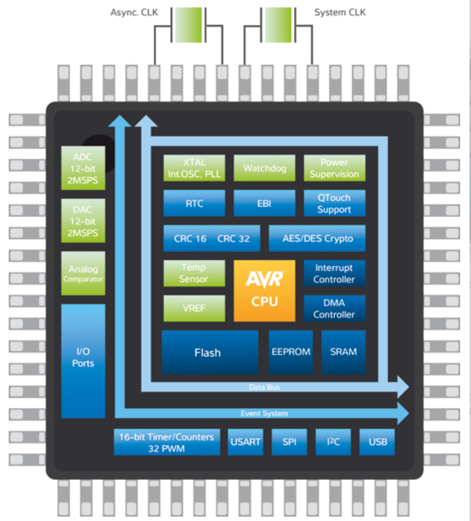
Microcontrollers
Typical Contents
CPU
Memory
Flash
Ram
Peripherals
Image from Atmel.com

Slide 7
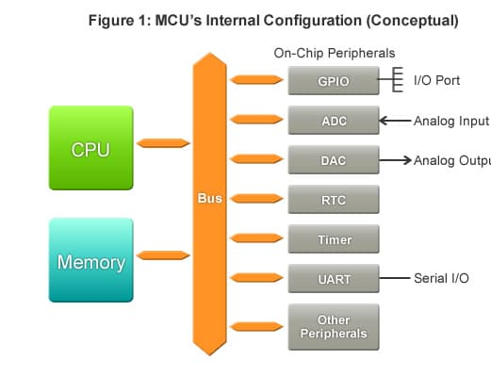
Peripherals
Receive
Send
Process
Image from Renasas.com

Slide 8
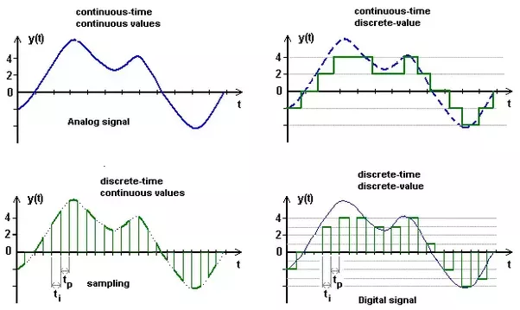
Analog vs Digital
Image from Quora.com

Slide 9
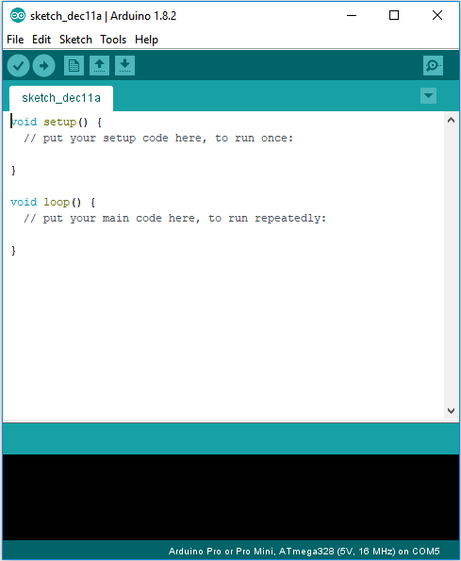
How do we use an Arduino?
C or C++
Arduino IDE is needed

Slide 10
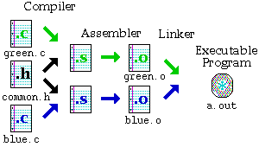
The magic of C programming
Image from Dartmouth.edu

Slide 11
Arduino Flow
SETUP
LOOP

Slide 12
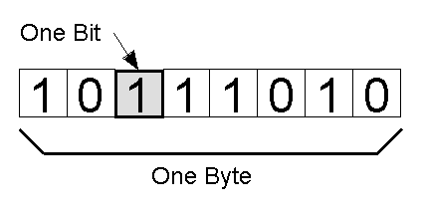
Programming
Data and Datatypes
void
boolean (1 byte)
char (1 byte)
int (2 bytes)
float (4 bytes)
…etc
Find more at https://playground.arduino.cc/Code/DatatypePractices
Image from Quora.com

Slide 13
Programming
Keywords mold the language
setup
loop
int
return
if
switch
break
while
Compiler directives
#define
#include

Slide 14
Programming
Functions = Datatypes + Operations + Other functions(optional)
Functions can return values
int my_function(int a)
{
return a + 1;
}
Functions may be referenced and defined in Libraries (.h files)

Slide 15
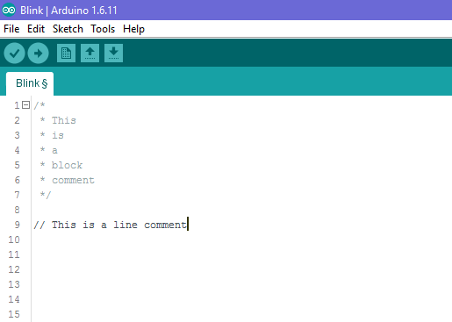
Comments

Slide 16
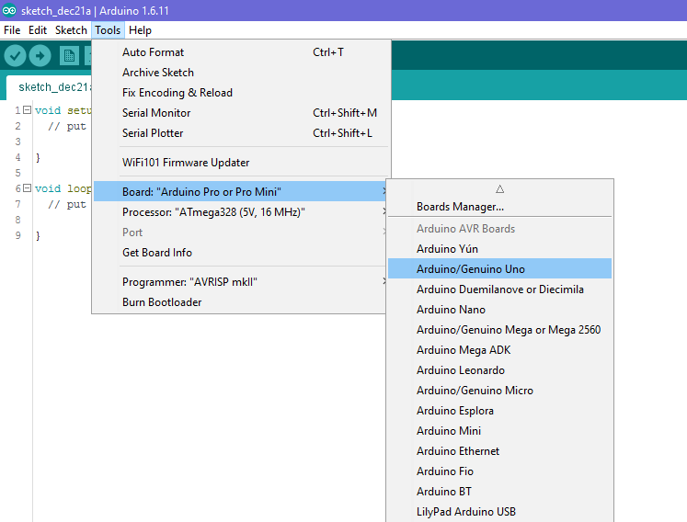

Slide 17
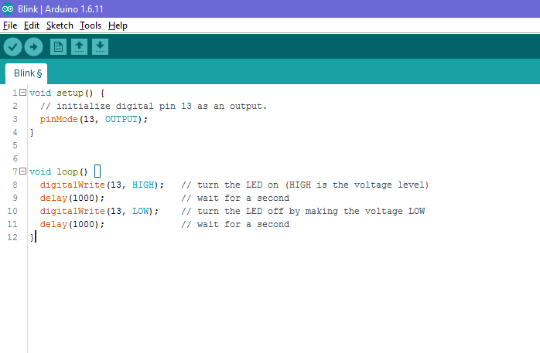

Slide 18


Slide 19
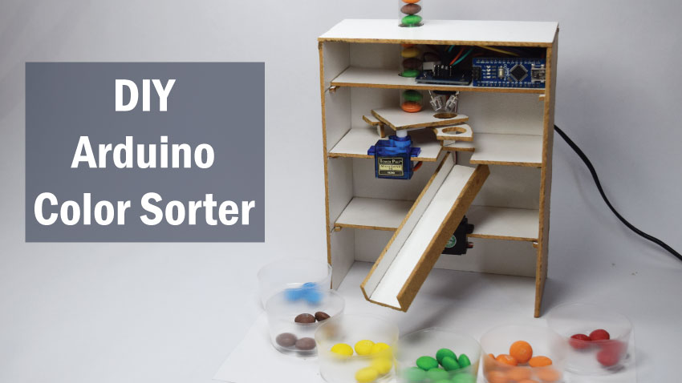
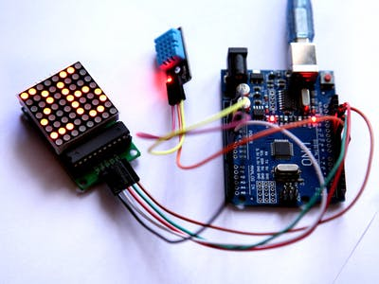
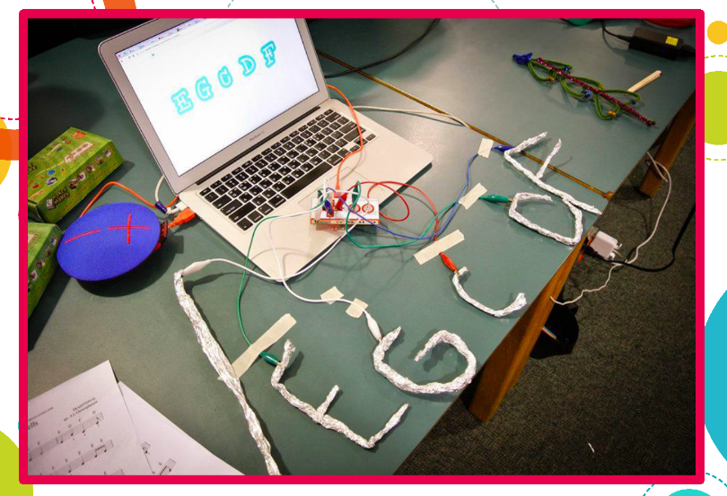
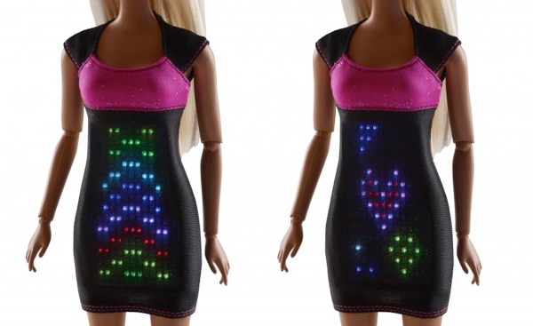
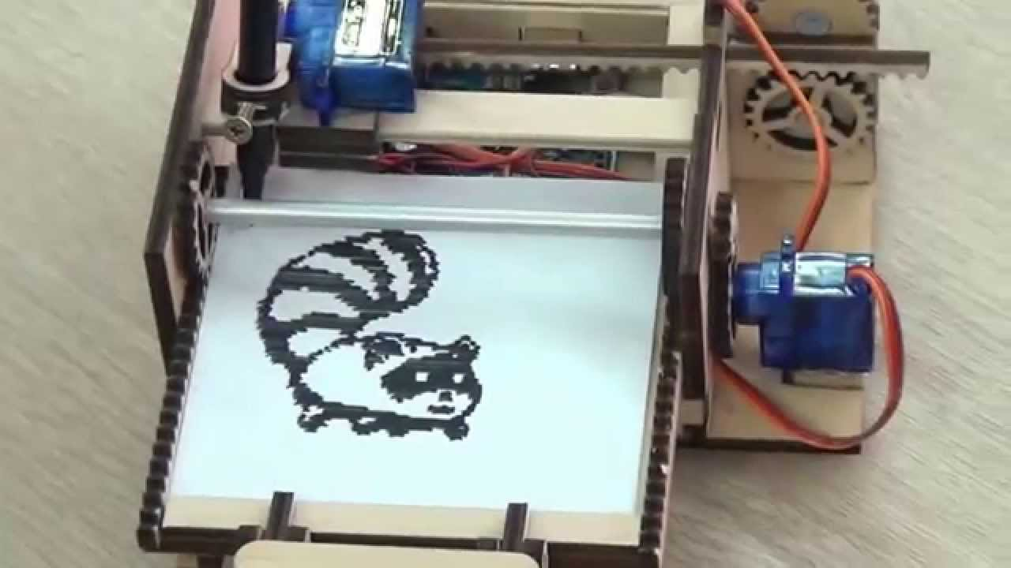
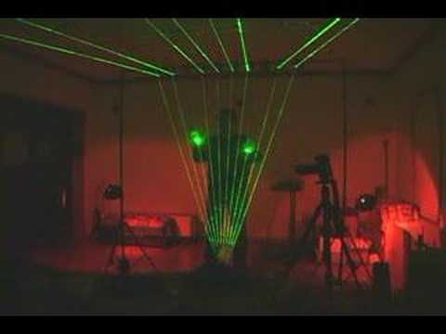
Sample Projects

